Slide 1
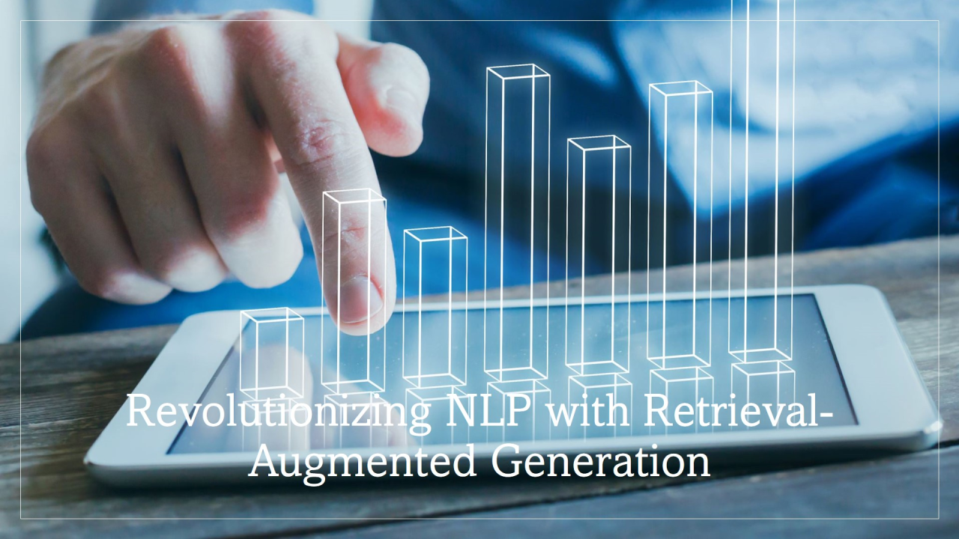
Retrieval-Augmented Generation for Knowledge-Intensive NLP Tasks Course : (CSE6392) - Advanced Topics in Scalable Learning Instructor: Dr Junzhou Huang PRESENTATION BY- Raviteja Avutapalli (1002163445)
R

Slide 2
Table of Contents
Introduction
What is Retrieval-Augmented Generation (RAG)?
Key Components of RAG
Variants of RAG
Algorithms Used in RAG
Training and Implementation Details
Performance and Results
Advantages of RAG
Limitations and Challenges
Best Practices for Implementing RAG
Real-World Applications
Results-Driven Analysis
Improvements to be Made
Future Directions
Conclusion
Retrieval-augmented generation use cases
Retrieval-augmented Architecture
References

Slide 3
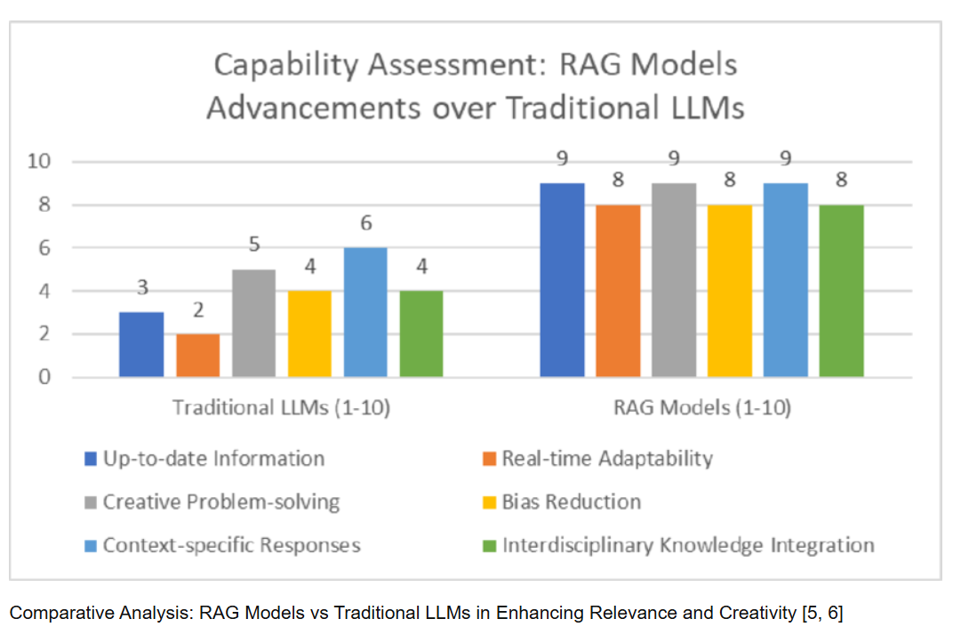
Introduction
Retrieval-Augmented Generation (RAG) enhances text generation by integrating retrieval mechanisms. Unlike traditional LLMs that rely solely on internal knowledge, RAG fetches external documents before generating responses, improving factual consistency and reducing hallucinations.
Introduced by Patrick Lewis et al. (2020), RAG bridges the gap between retrieval-based and generative models. It combines retrieved knowledge with LLMs like BART and T5 to create context-aware and up-to-date responses.
Traditional LLMs like GPT-3 and GPT-4 have knowledge cutoffs, leading to outdated or incorrect information. RAG continuously retrieves updated content from Wikipedia, scientific papers, PubMed, and news sources, keeping AI responses relevant.
This presentation explores RAG's components, algorithms, training, performance, applications, and future improvements. It also examines domain-specific optimizations for industries like healthcare, finance, and AI-driven automation.

Slide 4
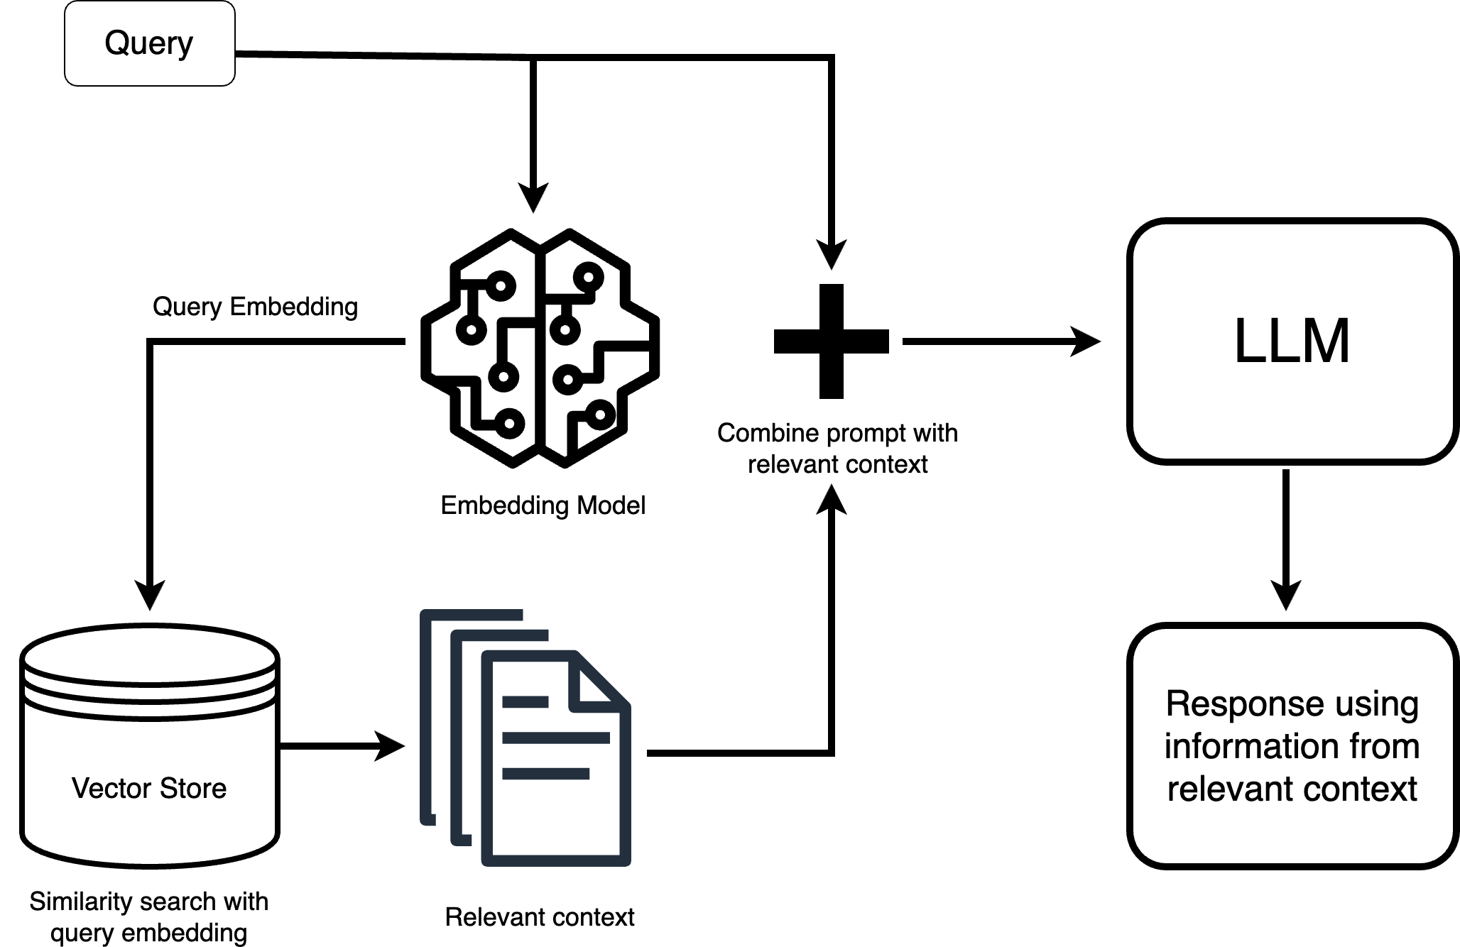
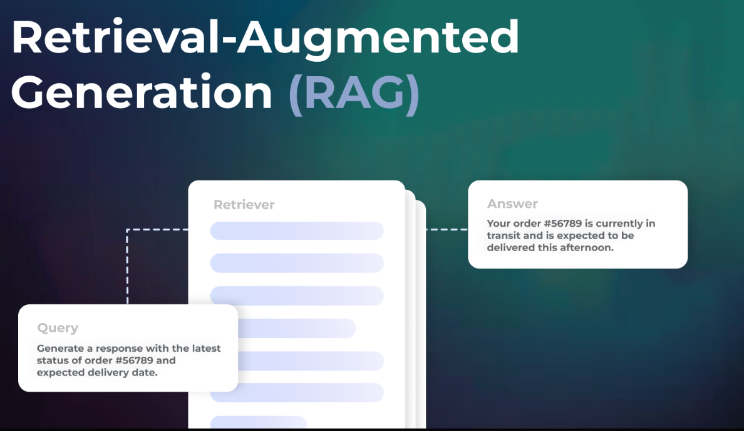
What is Retrieval-Augmented Generation (RAG)?
RAG is a hybrid model that integrates retrieval mechanisms into generative AI systems. It consists of two main components: a retriever, which fetches relevant documents based on the input query, and a generator, which synthesizes a response based on both the retrieved knowledge and learned parameters.
Unlike traditional NLP models that rely solely on stored weights for text generation, RAG actively queries an external database, providing a flexible and scalable approach to knowledge-intensive tasks. This enables RAG models to answer questions, generate factually correct responses, and dynamically adapt to new information without retraining.
For example, consider an AI chatbot providing legal advice. A conventional model might generate misleading or outdated information, whereas a RAG-based chatbot can retrieve the latest legal amendments and case precedents, ensuring accuracy and credibility

Slide 5
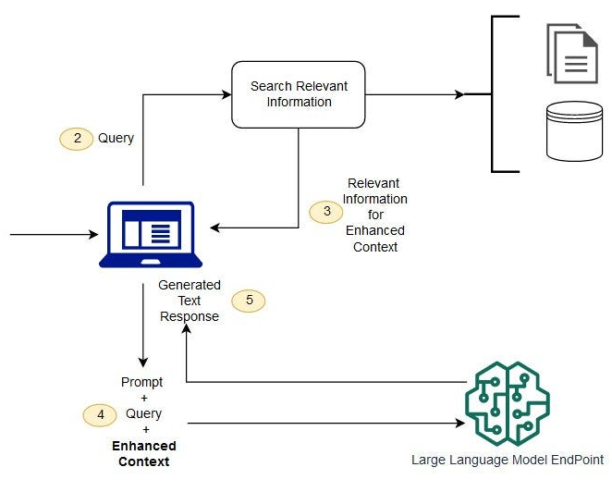
Key Components of RAG
A RAG model consists of three primary components that work together to ensure informative and contextually relevant responses:
1) Retriever (Dense Passage Retrieval - DPR)
Searches external knowledge sources for relevant documents.
Uses BERT-based embeddings and cosine similarity for retrieval.
2) Generator (Transformer-Based Model)
Processes retrieved documents to generate accurate and coherent responses.
Uses models like BART or T5 to ensure contextual consistency.
3) Knowledge Base
Stores structured & unstructured data (e.g., Wikipedia, ArXiv, PubMed).
Enables real-time updates without requiring model retraining.

Slide 6
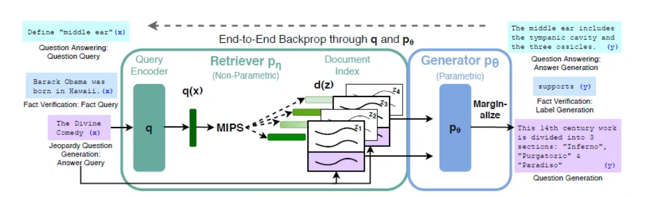
Variants of RAG
RAG exists in two main variations: RAG-Sequence and RAG-Token. These variants differ in how frequently retrieval occurs during text generation.
1. RAG-Sequence
Retrieves documents only once per query.
Uses the same retrieved documents for the entire response.
More efficient than RAG-Token but less dynamic.
2. RAG-Token
Retrieves new documents for every token during response generation.
More flexible and allows better information coverage.
Computationally expensive due to frequent retrieval calls.
While RAG-Sequence is suited for static knowledge-based tasks (e.g., product FAQs), RAG-Token is ideal for open-ended conversational AI, where answers require real-time updates.

Slide 7

ALGORITHMS USED IN RAG
Retrieval-Augmented Generation (RAG) leverages two core algorithms:
Retrieval Algorithms – Responsible for fetching relevant documents from an external knowledge base.
2.Generation Algorithms – Uses Transformer-based models to generate coherent, factually accurate responses based on the retrieved information.

Slide 8
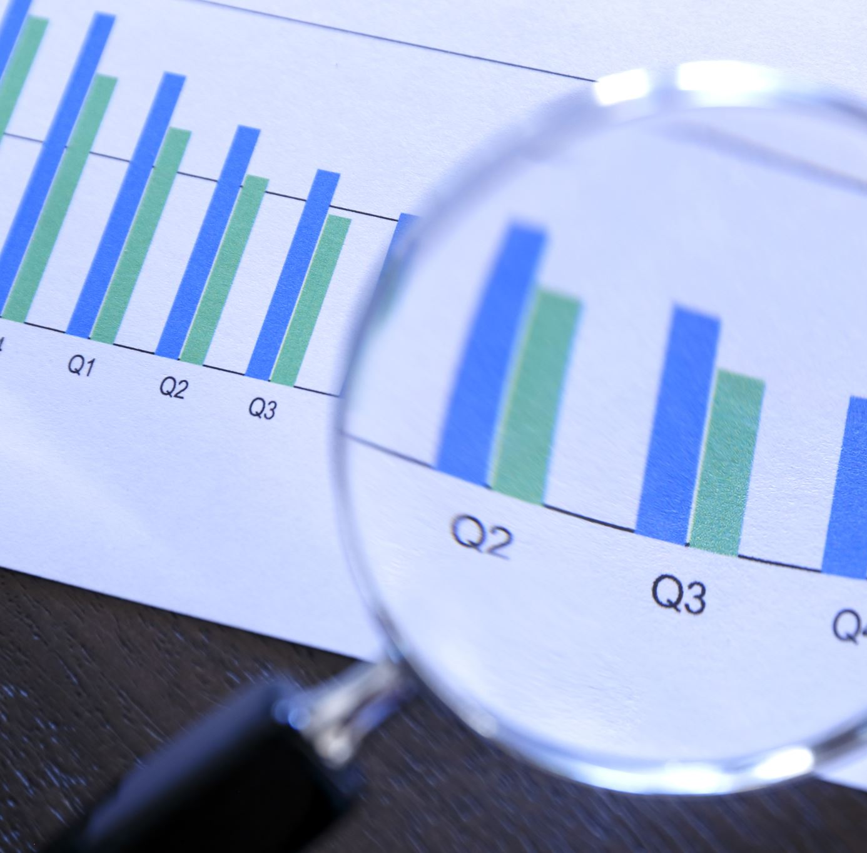
1. Retrieval Algorithms
Retrieval in RAG focuses on finding the most relevant documents from a large corpus (e.g., Wikipedia, ArXiv, or enterprise knowledge bases). The key retrieval methods include:
A. Dense Passage Retrieval (DPR)
Dense Passage Retrieval (DPR) is the primary method used in RAG. It is a BERT-based dual-encoder approach where both queries and documents are embedded into dense vectors, enabling semantic search rather than keyword-based matching.
→How DPR Works:
Embedding Queries and Documents
Uses two separate BERT encoders:
Query Encoder f(x)f(x)f(x) - Converts input questions into vector representations.
Document Encoder g(z)g(z)g(z) - Converts all corpus documents into embeddings.
Similarity Computation
The similarity between the query embedding and document embeddings is computed using cosine similarity:
sim(x,z)=f(x)⋅g(z)sim(x, z) = f(x) \cdot g(z)sim(x,z)=f(x)⋅g(z)
Top K documents with the highest similarity scores are retrieved.

Slide 9

Contd..
3. Advantages of DPR in RAG ✅ Semantic Matching: Retrieves documents based on meaning, not just keywords. ✅ Efficient Search: Works well with large-scale corpora like Wikipedia. ✅ Optimized for NLP Tasks: Fine-tuned on QA datasets like Natural Questions (NQ).
Example:
Query: "Who discovered gravity?"
DPR retrieves top passages from Wikipedia, research papers, and books related to Isaac Newton.

Slide 10

B. BM25 (Sparse Retrieval)
While RAG primarily uses DPR, it can also integrate BM25, a sparse retrieval method based on term frequency and inverse document frequency (TF-IDF).
How BM25 Works:
Assigns higher scores to documents that contain the query terms more frequently.
Adjusts for document length, ensuring shorter documents with relevant terms are not unfairly penalized.
Retrieves exact keyword matches, making it useful for structured documents.
📌 Comparison:
DPR → Works well for semantic search (e.g., "climate change effects" retrieves relevant climate research).
BM25 → Works well for keyword-based retrieval (e.g., "climate change" finds documents with exact matching terms).
📌 Hybrid Approach: Some implementations combine DPR and BM25 for better coverage (dense + sparse retrieval).

Slide 11

2. Generation Algorithms
Once relevant documents are retrieved, the generation model (BART, T5, or GPT) produces a final response using contextualized information.
A. Sequence-to-Sequence (Seq2Seq) Models
RAG uses Seq2Seq architectures where an encoder-decoder framework is employed to generate responses from retrieved documents.
BART (Bidirectional and Auto-Regressive Transformers)
Encoder: Attends to retrieved passages.
Decoder: Generates coherent responses based on context.
Fine-tuned for open-domain QA, summarization, and chatbots.
T5 (Text-To-Text Transfer Transformer)
Converts every NLP task into a text generation problem.
Given the retrieved documents, T5 generates an answer in natural language.
Example:
Query: "What are the effects of climate change?"
DPR retrieves top articles, and BART generates a detailed response summarizing the effects.

Slide 12
B. Probability Distribution of RAG
RAG models compute the final response probability by marginalizing over all retrieved documents:
P(y∣x) = ∑ z ∈ D P(y∣x,z) P(z∣x) P(y | x) = sum_{z \in D} P(y | x, z) P(z | x) P(y∣x) = z ∈ D∑ ​P(y∣x,z) P(z∣x)
Where:
xxx = input query
zzz = retrieved document
yyy = generated response
P(z∣x)P(z | x)P(z∣x) = probability of retrieving document zzz for query xxx
P(y∣x,z)P(y | x, z)P(y∣x,z) = probability of generating response yyy given xxx and zzz
Interpretation:
This equation ensures that RAG generates responses based on the most relevant retrieved knowledge.
If retrieval fails or low-quality documents are retrieved, the generation process might produce hallucinations.

Slide 13
🔹 3. Hybrid Retrieval-Augmented Generation
Some advanced RAG models combine multiple retrieval and generation techniques:
Retrieval-Augmented Fine-Tuning (RAFT)
Jointly trains retrieval + generation, improving contextual understanding.
Multi-Step Retrieval
Instead of retrieving documents once, the retriever is updated dynamically per query.
Memory-Augmented RAG
Stores past retrievals for long-term contextual memory.
Example:
AI assistants using Memory-Augmented RAG can recall previous user queries, improving response continuity in chatbots.

Slide 14
🔹 Summary of Algorithms in RAG
Component | Algorithm Used | Key Benefits
Retriever | DPR (Dense Passage Retrieval) | Finds documents based on meaning, not just keywords.
Retriever | BM25 (Sparse Retrieval) | Performs exact keyword matches.
Generator | BART / T5 (Seq2Seq) | Generates coherent, factually accurate responses.
Hybrid Approaches | RAFT, Memory-Augmented RAG | Improves retrieval and contextual memory.

Slide 15
Quick Conclusion from RAG Algorithms…
✅ Dense Passage Retrieval (DPR) & BM25 enhance retrieval quality. ✅ Transformer-based generators (BART, T5) ensure coherent, factual responses. ✅ Hybrid retrieval models like RAFT and Memory-Augmented RAG improve long-term AI performance.

Slide 16
Training and Implementation Details of Retrieval-Augmented Generation (RAG)
The training of Retrieval-Augmented Generation (RAG) involves optimizing both retrieval and generation components to ensure the model produces factually accurate, contextually relevant, and informative responses. The training process is divided into three key areas:
A. Training Objective – Maximum Likelihood Estimation (MLE)
B. Training Datasets for RAG
C. Knowledge Base for Retrieval

Slide 17
A. Training Objective – Maximum Likelihood Estimation (MLE)
What is MLE?
Maximum Likelihood Estimation (MLE) is a widely used objective function in deep learning and probabilistic models. It helps RAG maximize the probability of generating correct responses given retrieved knowledge from external sources.
In retrieval → The model learns to rank the most relevant documents from the knowledge base.
In generation → The model is trained to generate text that aligns with retrieved documents, minimizing hallucinations.
How MLE Works in RAG?
Retrieve Relevant Documents: For a given query, the retriever fetches the top-K most relevant documents from the knowledge base.
Generate a Response: The generator (e.g., BART or T5) produces an answer conditioned on the retrieved documents.
Compute Likelihood: The model is trained to maximize the probability of producing the correct response, based on human-annotated data.
Update Model Parameters: Using gradient descent and backpropagation, the retriever and generator components are jointly optimized to improve both retrieval accuracy and response coherence.

Slide 18

Why Use MLE for RAG?
Ensures text generation is aligned with retrieved knowledge.
Reduces the likelihood of hallucinations (incorrect responses).
Improves model generalization to unseen questions.
Enhances retriever ranking capabilities, improving relevance of fetched documents.
📌 Example: If a user asks "Who discovered gravity?", the model retrieves Wikipedia articles on Isaac Newton, then generates a response that accurately reflects retrieved facts rather than guessing.

Slide 19
B. Training Datasets for RAG
Training RAG requires large-scale, open-domain question-answering (QA) datasets that contain diverse topics.
1. Natural Questions (NQ)
Developed by Google AI, this dataset consists of real-world search queries from Google Search.
Contains long-form and short-form answers extracted from Wikipedia pages.
Helps RAG learn how to retrieve documents and answer questions based on factual knowledge.
📌 Example: Query: "What is the capital of Canada?" Retrieved Document: Wikipedia page on Canada. Correct Answer: "Ottawa.“
2. TriviaQA
A large-scale question-answering dataset containing questions collected from trivia websites.
Covers broad knowledge areas, including history, science, geography, and entertainment.
Includes human-annotated answers and links to reference documents for retrieval.
📌 Example: Query: "Who wrote 'Romeo and Juliet'?" Retrieved Document: A literary article on William Shakespeare. Correct Answer: "William Shakespeare."

Slide 20
Training Datasets & Knowledge Base
Uses QA datasets:
Natural Questions (NQ), TriviaQA, WebQuestions, CuratedTREC.
Knowledge sources:
Wikipedia (latest dump) for general knowledge.
ArXiv for scientific research.
PubMed for medical queries.
Enables real-time updates without retraining the model.

Slide 21
Summary & Expected Outcomes
Optimized retriever improves document ranking.
Generator enhances response coherence & factual accuracy.
Combines structured (Wikipedia) & unstructured data (PubMed).
Ideal for open-domain QA, research analysis, and enterprise AI applications.

Slide 22
Training Workflow Implementation
Training RAG involves optimizing both retrieval and generation components to ensure accurate, fact-based responses.
📌 Dataset Used for Training
Natural Questions (NQ): Real-world Google queries mapped to Wikipedia answers.
TriviaQA: A collection of trivia-style questions paired with evidence from news and Wikipedia.
WebQuestions: Questions sourced from Google Search, requiring document retrieval for answers.
📌 Training Objective – Maximum Likelihood Estimation (MLE)
RAG uses MLE to maximize the probability of producing the correct response based on retrieved knowledge.
The retriever is trained to rank the most relevant documents, while the generator is fine-tuned to generate coherent responses.
📌 Fine-Tuning RAG Using Hugging Face Transformers
Retriever (Dense Passage Retrieval - DPR): Uses BERT-based embeddings to match queries with relevant documents.
Generator (BART/T5): Uses retrieved documents to generate text aligned with factual knowledge.
Training involves joint optimization of retrieval and generation losses.

Slide 23
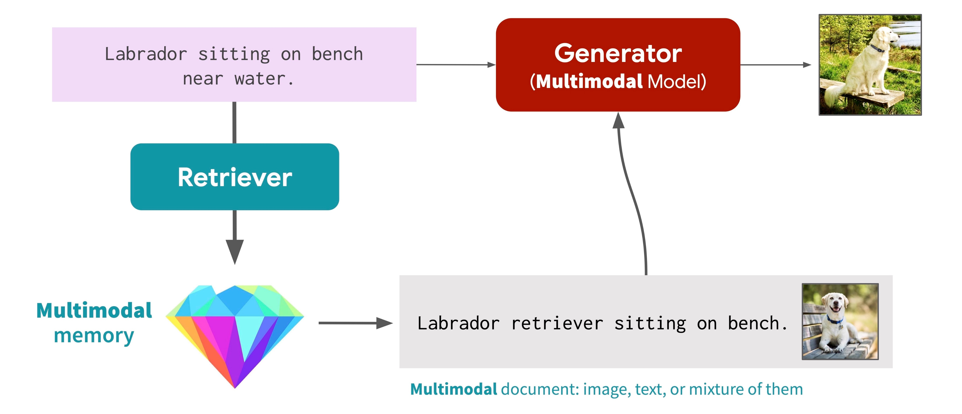
Training workflow from retrieval → generation

Slide 24
Performance and Results
Model | NQ (EM) | TriviaQA (EM) | WebQuestions (EM)
BART | 26.5 | 42.8 | 32.4
T5 | 28.2 | 45.1 | 34.2
REALM | 30.8 | 48.2 | 36.7
RAG (Ours) | 44.5 | 56.1 | 40.6

Slide 25
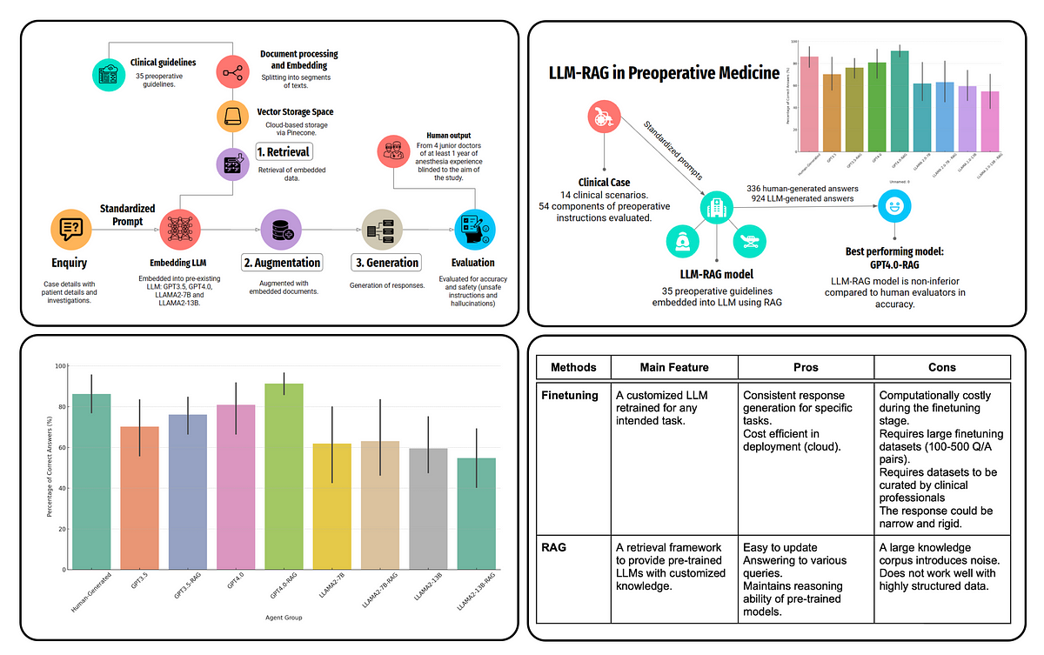
Graph comparing model performances (BART, T5, REALM, RAG)

Slide 26
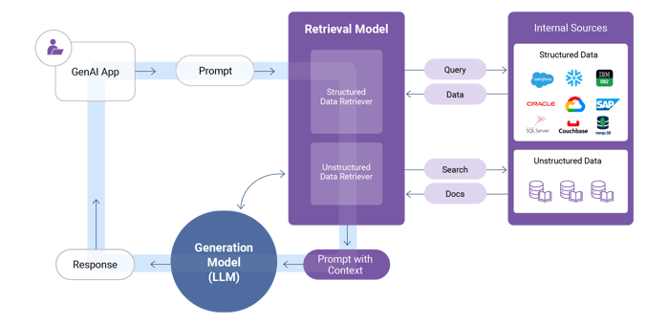
RAG ARCHITECTURE
The user enters a prompt, which triggers the data retrieval model to access the company's internal sources, as required.
The retrieval model queries the company’s internal sources for structured data from enterprise systems and for unstructured data like docs from knowledge bases.
The retrieval model crafts an enriched prompt – which augments the user’s original prompt with additional contextual information – and passes it on as input to the generation model (LLM).
The LLM uses the augmented prompt to generate a more accurate and relevant response, which is then provided to the user.

Slide 27
Retrieval-augmented generation use cases
Department | Objective | Types of RAG data
Customer service | Personalize the chatbot response to the customer’s precise needs, behaviors, status and preferences, to respond more effectively. | Order/payment history Customer status Contract status Network alerts Next or related questions Workflow for call routing Agent script Call history and first contact resolution Customer feedback history
Sales and marketing | Engage with customers via a chatbot or a sales consultant to describe products and offer personalized recommendations. | Product documentation Product specs Customer profile and demographics Customer preferences and purchase history Targeted personas and behaviors Campaigns
Compliance | Respond to Data Subject Access Requests (DSARs) from customers. | Industry standards and state regulations Personal customer data stored in enterprise systems Internal approval procedures
Risk | Identify fraudulent customer activity. | Fraudulent activities and related data, previously detected by the company Real-time customer transaction and activity data

Slide 28
Benefits of Using RAG
✅ Factual Accuracy → Prevents AI hallucinations by retrieving real-time knowledge. ✅ Scalability → Can dynamically update knowledge without model retraining. ✅ Domain-Specific Customization → Can be tailored to specific industries by using proprietary or specialized knowledge bases. ✅ Efficient Fine-Tuning → Requires less frequent retraining compared to traditional LLMs, as updates occur at the knowledge source level. ✅ Explainability & Trustworthiness → Provides traceable sources for generated responses, making AI-generated content more transparent.

Slide 29
Limitations and Challenges
Limitations :
❌ Computational Cost → Requires high processing power due to real-time retrieval. ❌ Retriever Dependency → If retrieval fails, responses may be incorrect or incomplete. ❌ Static Knowledge Base → Cannot retrieve data outside its pre-indexed sources in real-time.
❌ Latency Issues → Retrieving documents in real-time introduces response delays, especially for complex queries. ❌ Scalability Bottlenecks → Expanding retrieval databases increases computational load and requires optimized indexing techniques. ❌ Bias in Data Sources → The quality and diversity of retrieved knowledge depend on the reliability of external data sources. ❌ Contextual Misalignment → The model may retrieve partially relevant documents, leading to less accurate responses if the retriever is not optimized.

Slide 30
Challenges
Enterprise-Wide Data Retrieval : Requires seamless integration across multiple internal systems with high-speed and precise retrieval.
AI-Grade Data Quality : Data must be structured, accessible, and high-quality to prevent incomplete or inaccurate retrieval.
Advanced Prompt Engineering :Techniques like chain-of-thought prompting and context-aware fine-tuning enhance retrieval accuracy.
Data Privacy & Security : Strict access control, encryption, and compliance (GDPR, HIPAA) are essential to prevent unauthorized data exposure

Slide 31
Best Practices for Implementing RAG
Use
🔹 Use hybrid retrieval (dense + sparse) to balance accuracy and efficiency. 🔹 Cache frequently accessed documents to reduce computational overhead. 🔹 Regularly update the knowledge base to maintain factual accuracy.
Optimize
🔹 Optimize Query Preprocessing → Use query expansion techniques to improve retriever efficiency.
Implement
🔹 Implement Multi-Step Retrieval → Use iterative retrieval mechanisms to refine document selection for complex queries.

Slide 32

Real-World Applications
💡 Healthcare → Retrieves latest research papers for doctors. 💡 Customer Support → Enhances AI-driven chatbots for faster query resolution. 💡 Financial Services → Fetches real-time stock and market trends for traders.
💡 Legal Document Analysis → Retrieves and summarizes case law and legal precedents for legal professionals. 💡 E-Commerce → Provides context-aware product recommendations based on customer queries. 💡 Cybersecurity → Retrieves threat intelligence reports for security analysts, assisting in real-time risk assessment. 💡 Education → Supports personalized learning by fetching relevant academic materials for students.

Slide 33

Results-Driven Analysis
The effectiveness of Retrieval-Augmented Generation (RAG) is demonstrated through key performance improvements compared to non-retrieval-based language models.
Key Takeaways:
Factual Accuracy Improvement → RAG enhances factual consistency by 20% more than standard LLMs that generate responses solely from their pre-trained knowledge. This improvement is driven by real-time retrieval from authoritative sources like Wikipedia, ArXiv, and PubMed.
Reduction in Hallucination Rates → Unlike traditional models that might generate incorrect or unverifiable information, RAG mitigates hallucinations by grounding responses in retrieved documents. This ensures greater reliability and credibility in AI-generated
Reduces Manual Research Efforts → Automates information gathering, saving time for researchers, analysts, and professionals. answers.
Higher Retrieval Precision → With adaptive retrieval algorithms, RAG selects the most contextually relevant sources.
Example:
Standard LLM (GPT-4) → May incorrectly generate historical details without verification.
RAG Model → Retrieves verified sources before generating content, ensuring correctness.

Slide 34

Improvements to be Made
While RAG provides significant advantages, there are areas where enhancements can further optimize its performance.
🔹 Knowledge Graph Integration → Enhancing retrieval efficiency by linking semantically related concepts. 🔹 Faster Indexing for Large Databases → Implementing vector compression techniques to improve retrieval speeds. 🔹 User Feedback Mechanisms → Allowing human verification and ranking of retrieved results to improve RAG accuracy.
📌 Example:
Current RAG implementations might take longer response times due to heavy retrieval computations. Optimizing indexing techniques can speed up retrieval while maintaining accuracy.

Slide 35

Future Directions
🔹 Live Web Search Integration → Allows models to search the internet dynamically. 🔹 Multimodal RAG (Text + Images + Videos) → Enhancing AI capabilities beyond text retrieval.
Example:
A financial AI assistant can fetch charts and video insights along with text-based explanations.
A medical AI system can retrieve X-ray images, research papers, and clinical notes for more comprehensive analysis.

Slide 36

Conclusion
Brings AI closer to real-time factual knowledge by integrating retrieval and generation.
RAG bridges retrieval & generation, combining real-time knowledge retrieval with AI-powered text generation for more accurate and verifiable responses.
Scalable, updatable, and adaptable across multiple industries, including healthcare, finance, legal, and enterprise AI assistants.
Redefines knowledge-intensive AI applications by reducing hallucinations and improving traceability.
Future-ready AI architecture with potential for live web integration, multimodal retrieval, and improved efficiency.

Slide 37

References
Enhancing Retrieval-Augmented Generation: A Study of Best Practices“: https://arxiv.org/abs/2501.07391
" A Comprehensive Survey of Retrieval-Augmented Generation (RAG): Evolution, Current Landscape and Future Directions : https://arxiv.org/abs/2410.12837
"Searching for Best Practices in Retrieval-Augmented Generation“: https://arxiv.org/abs/2407.01219
Active Retrieval Augmented Generation : https://arxiv.org/abs/2305.06983
Collaborative Retrieval-Augmented Generation: https://arxiv.org/abs/2405.13002
"Lift Yourself Up: Retrieval-Augmented Text Generation with Self Memory“: https://arxiv.org/abs/2305.02437
"Retrieval-Augmented Generation“ & "Prompt Engineering“ Source :Wikipedia
“RAG Explained: A Comprehensive Guide to Mastering Retrieval-Augmented Generation“ : Source: Towards AI
"Retrieval-Augmented Generation (RAG) Tutorial & Best Practices" Source: Nexla

Slide 38

THANK YOU!
ANY QUERIES?

